Slide 1
Modification of the Database
part5

Slide 2
Modification of the Database
Insert tuples in a relation
Deletion of tuples from a given relation
Insertion of new tuples into a given relation
Updating values in some tuples in a given relation

Slide 3
Insert into ..values
syntax
INSERT INTO table_name (column1, column2, column3, ...) VALUES (value1, value2, value3, ...);
INSERT INTO table_name VALUES (value1, value2, value3, ...);

Slide 4
Modification of the Database – Insertion
Add a new tuple to course
insert into course values (’CS-437’, ’Database Systems’, ’Comp. Sci.’, 4);
or equivalently insert into course (course_id, title, dept_name, credits) values (’CS-437’, ’Database Systems’, ’Comp. Sci.’, 4);
Add a new tuple to student with tot_creds set to null
insert into student values (’3003’, ’Green’, ’Finance’, null);
Notes:
4

Slide 5
Example table
CREATE TABLE Persons ( Customerid int NOT NULL AUTO_INCREMENT, CustomerName varchar(20),
ContactName varchar(20),
Address, City varchar(20),
PostalCode int(10),
Country varchar(20),
PRIMARY KEY (Customerid ) );

Slide 6
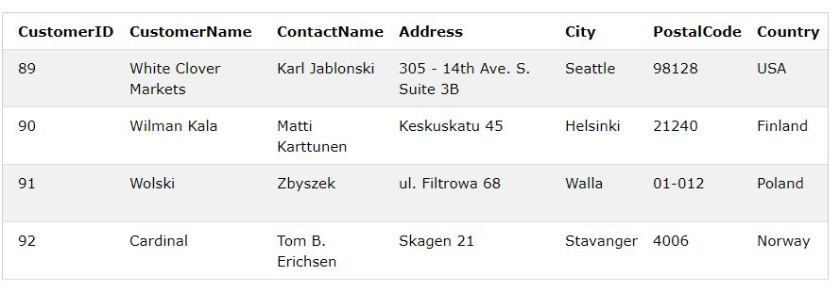
INSERT INTO Customers (CustomerName, ContactName, Address, City, PostalCode, Country) VALUES ('Cardinal', 'Tom B. Erichsen', 'Skagen , 21', 'Stavanger', '4006', 'Norway');

Slide 7
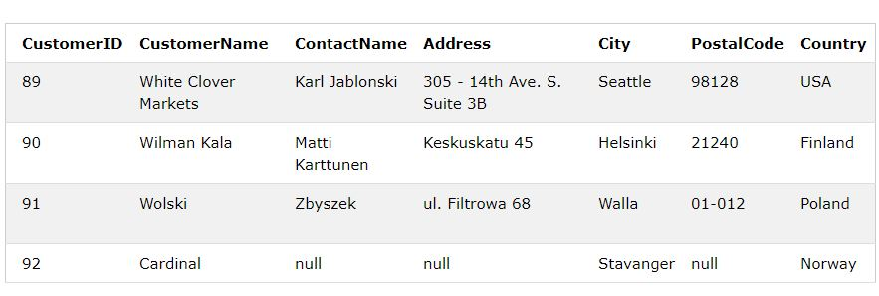
Insert Data Only in Specified Columns
INSERT INTO Customers (CustomerName, City, Country) VALUES ('Cardinal', 'Stavanger', 'Norway');

Slide 8
Insertion (Cont.)
Add all instructors to the student relation with tot_creds set to 0
student(SID, name, dept_name, tot_cred)
instructor(ID, name, dept_name, salary)
insert into student select ID, name, dept_name, 0 from instructor
The select from where statement is evaluated fully before any of its results are inserted into the relation (otherwise queries like
insert into student select * from student
might insert an infinite number of tuples, if the primary key constraint on student were absent.)
Notes:
8

Slide 9
deletion
DELETE FROM table_name WHERE condition;
DELETE FROM Customers WHERE CustomerName='Alfreds Futterkiste';

Slide 10
Modification of the Database – Deletion
Delete all instructors
delete from instructor
Delete all instructors from the Finance department delete from instructor where dept_name= ’Finance’;
Delete all tuples in the instructor relation for those instructors associated with a department located in the Watson building.
delete from instructor where dept_name in (select dept_name from department where building = ’Watson’);
Notes:
10

Slide 11
Deletion (Cont.)
Delete all instructors whose salary is less than the average salary of instructors
delete from instructor
where salary< (select avg (salary) from instructor);
Notes:
11

Slide 12
updation
The UPDATE statement is used to modify the existing records in a table.
UPDATE table_name SET column1 = value1, column2 = value2, ... WHERE condition;
UPDATE Customers SET ContactName = 'Alfred Schmidt', City= 'Frankfurt‘ WHERE CustomerID = 1;
UPDATE Customers SET ContactName='Juan';

Slide 13
Modification of the Database – Updates
Increase salaries of instructors whose salary is over $100,000 by 3%, and all others receive a 5% raise
Write two update statements:
update instructor set salary = salary * 1.03 where salary > 100000;
update instructor set salary = salary * 1.05 where salary <= 100000;
The order is important
Can be done better using the case statement (next slide)
Notes:
13

Slide 14
Case Statement for Conditional Updates
Same query as before but with case statement
update instructor set salary = case when salary <= 100000 then salary * 1.05 else salary * 1.03 end
The general form of the case statement is as follows.
CASE WHEN condition1 THEN result1 WHEN condition2 THEN result2 WHEN conditionN THEN resultN ELSE result END;
Notes:
14
The operation returns resulti, where i is the first of pred1, pred2, . . . , predn that is satisfied; if none of the predicates is satisfied, the operation returns result0

Slide 15
The following SQL will order the customers by City. However, if City is NULL, then order by Country:
SELECT CustomerName, City, Country FROM Customers ORDER BY (CASE WHEN City IS NULL THEN Country ELSE City END);

Slide 16
Updates with Scalar Subqueries
Recompute and update tot_creds value for all students
set the tot cred attribute of each student tuple to the sum of the credits of courses successfully completed by the student
update student S set tot_cred = ( select sum(credits) from takes natural join course where S.ID= takes.ID and takes.grade <> ’F’ and takes.grade is not null);
Notes:
Instead of sum(credits), use:
case when sum(credits) is not null then sum(credits) else 0 end
16
We assume that a course is successfully completed if the student has a grade that is not ’F’ or null.

Slide 17
End of Chapter 3
Notes:
17

